Slide 1

npm i kinvey-node-sdk
(aka “Get Started with Kinvey”)
Notes:
The cloud offers so much promise, but many cloud offerings can be notoriously difficult to navigate – even for an experienced developer. Progress Kinvey makes the cloud easier. In this session, we’ll take a look at building our first application using Kinvey. We’ll explore features like the cloud datastore, authentication and serverless functions – all from the developer’s perspective (i.e. with code samples).

Slide 2
Kinvey:
why?
what?
who?
how?

Slide 3
why? DISRUPTION

Slide 4
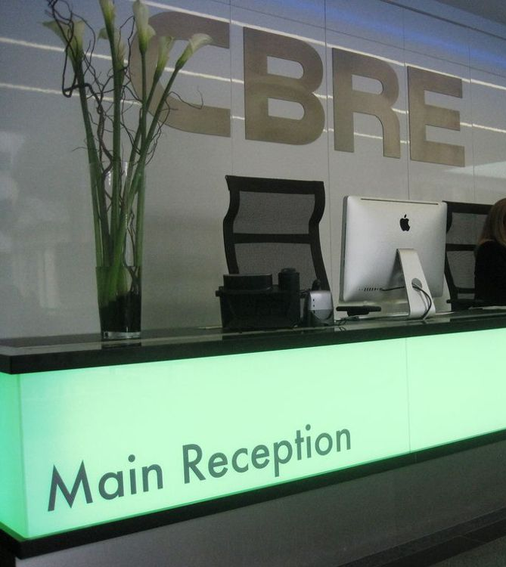

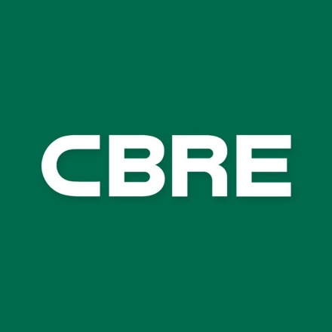

Notes:
CBRE, a pretty well-known real-estate company is facing stiff competition from wework, which is doing some pretty cool things from a technological perspective, just in terms of how they manage their facilities.

Slide 5




Notes:
You all know Bose…
Maker of premium audio gear, unmatched quality,
Being disrupted by the likes of Apple and Amazon
Music the way you want it, where you want it
Another company I met was Sysco – not the networking company – the food distribution company

Slide 6




Notes:
Sysco has phenomenal relationships…
Hotel chains… restaurants… hospital systems…
Designed for high volume shipments…
Being disrupted by Amazon and Costco!
Retailers who have built a warehouse and distribution system backed by tech
This disruption is everywhere, so how does Kinvey help you deal with this?

Slide 7
what? IS KINVEY

Slide 8
who? USES KINVEY

Slide 9
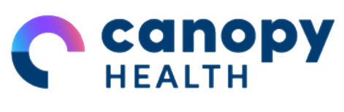

70% faster delivery of HIPAA compliant apps
 | Waterfall | With PHC | Average savings
Time | 18-20 weeks | 6 weeks | 70%
Costs | Avg $155/yr = $496,000 | Avg $155/yr = $148,800 | 70%
Maintenance | $56,280/mo | $7,440/mo | 85%
“After doing our research, Progress Health Cloud was the most reliable and mature platform. We also liked that Progress had a short-term and long-term vision for the healthcare space.”
Pamela Hudson, Chief Information Officer, Canopy Health
Notes:
https://www.progress.com/customers/canopy-health
Challenge Canopy Health, an accountable care organization, is dedicated to providing a better quality of healthcare to people residing in the Bay Area. With a large network of physicians and providers, Canopy Health puts a special emphasis on making care more accessible, transparent and affordable for all members. As a patient-centric provider, Canopy Health wanted to focus on providing a better healthcare experience that simplified many of the complexities surrounding the process. It quickly became apparent that one of the best ways of doing this was by creating a streamlined digital experience across mobile and desktop platforms that was not only patient-friendly but also high impact. To create this new digital ecosystem, Canopy Health realized that with people increasingly using mobile devices to take care of daily tasks, their new strategy would have to be developed with a “mobile first” mindset. However, tackling the expansive mobile landscape is a hurdle that has tripped up many healthcare organizations in the past due to its complexity. The challenge is two-fold:
Developing mobile apps is difficult due to the sheer number of different operating systems and platform specifications. Building an application with a good user experience across all of these platforms requires a lot of time and energy.
Even once the application has been developed, maintaining an application across multiple platforms is still difficult and cumbersome.

Slide 10

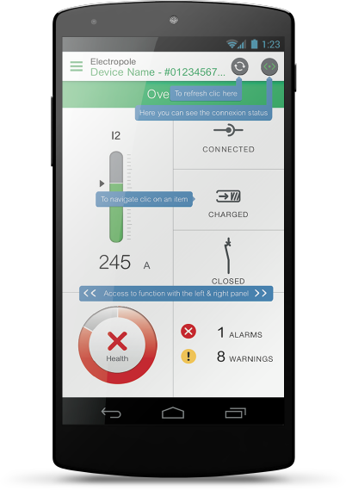
IT costs deceased 30-40% delivering cross platform apps with only web developers
“It helps us save on development and IT costs by at least 30-40 percent, for time and money.”
Mahesh Balasubramanian, Senior Global Architect at Schneider Electric
© 2018 Progress Software Corporation and/or its subsidiaries or affiliates. All rights reserved.
Notes:
Schneider Electric is a Kinvey customer that was looking to reduce their DevOps overhead, and they’re also doing some pretty cool things with Internet of Things devices, and found Kinvey to be a pretty good fit for that.
https://www.progress.com/customers/schneider-electric-success
Challenge
Schneider Electric has 50 different product lines with operations in more than 100 countries across North America, Europe and Asia Pacific. The company focuses on providing integrated energy management solutions that are safe, reliable, efficient, productive and green.
Senior leaders at Schneider Electric recognized the importance of driving product innovation by leveraging mobile, web and the Internet of Things for the company’s energy management businesses. They wanted to build unique and engaging apps for the commercial and consumer energy management businesses to drive new revenue opportunities, reduce costs and improve customer satisfaction. Solution
The Schneider Electric CTO launched an initiative to provide a mobile innovation platform and development framework to fuel innovation, improve efficiency, reduce time-to-market and offer cost savings while enabling a consistent user experience. Schneider Electric selected Progress® Kinvey™ to be the heart of the company’s new mobile innovation platform. The company is working with Kinvey to provide a consistent user experience and enable the art of the possible. After evaluating the options, Schneider Electric determined that the Dedicated Kinvey deployment model would be the most effective. It provided Schneider Electric with a worldwide, dedicated instance of Kinvey in data centers in North America, EMEA and Asia Pacific to support the company’s global developer workforce. With Kinvey, Schneider Electric’s developers were able to spend more time working on critical value-added features instead of rebuilding the infrastructure for each new application that had to be developed. “Product innovation is important to us, and harnessing the power of mobile gives us a competitive advantage,” explained Ken Carroll, Vice President Software Platforms, Schneider Electric. “Kinvey makes it simple with no IT overhead. Decoupling the user interface from the backend allows our developers to focus on product innovation instead of building or maintaining the backend platform.”

Slide 11


109 year old company makes Mobility a reality
“If you’ve worked with SAP systems as long as I have, you know that it’s no simple thing to extend an ERP system with mobility.
With Kinvey…the performance has been unbelievable. I went from 14-second SAP data access down to 400-millisecond mobile-friendly data access.”
Anubhav Gupta, director of SAP applications at Bell and Howell
© 2018 Progress Software Corporation and/or its subsidiaries or affiliates. All rights reserved.
Notes:
https://www.businesswire.com/news/home/20180808005072/en/Bell-Howell-Revolutionizes-Field-Service-Delivery-Progress
Boasting a rich history and expertise in mechatronics and workflow efficiency, Bell and Howell delivers comprehensive automation solutions in retail click-and-collect, pharmaceutical factory intelligence, production mail, consumer packaging automation and omnichannel communication. With more than 700 service personnel deployed throughout North America and Canada, field productivity is critical to their success.
Bell and Howell was an early leader in mobile app development, launching its first mobile app in 2004. However, as the mobile landscape has evolved, the company quickly realized that it not only needed to update its mobile app to better enable its field technicians, but had to build out an application infrastructure that would enable users to access the data in its SAP systems quickly and easily.
To make this vision a reality, Bell and Howell turned to Progress and its high-productivity application platform, Kinvey, to provide cost-effective, zero-code, configurable integration to SAP as part of its full-featured mobile application-development platform. With Progress, Bell and Howell has launched a modern, efficient mobile service application and dramatically reduced SAP data access response time from tens of seconds to milliseconds. The new application platform has also helped the company increase the speed at which its technicians can communicate and connect with other backend systems, call centers and customers.
“In order to maintain our reputation as an industry-leading field service organization, we selected Progress Kinvey to deliver faster field access to our data-rich SAP systems,” said Jim Feely, SVP Global Business Services, Bell and Howell. “With the new mobile field service app, our technicians are working much more effectively and efficiently.”
Through the new field service mobile app technicians can view the history of a machine, share information and images, scan parts, create and view slow-motion videos, and – most importantly – capture true parts history. They can also process service transactions and respond quickly to customer requests while providing back-office operations with insight on service delivery and productivity. Additional benefits include the ability to determine precisely how many hours or cycles a part has been in use and whether multiple technicians have encountered the same or similar issues. Based on that data, the company can take preemptive action to replace a part before it fails. The app also helps with product tracking – locating parts in stock at other locations to streamline the ordering and delivery process.
“Field technicians are on the front lines – their effectiveness impacts the customer experience and the value the customer gets from the company’s products,” said Dmitri Tcherevik, Chief Technology Officer, Progress. “With Progress Kinvey high-productivity application platform, Bell and Howell is revolutionizing the value they deliver to customers, and the efficiency with which their field teams work.

Slide 12


